Slide 1
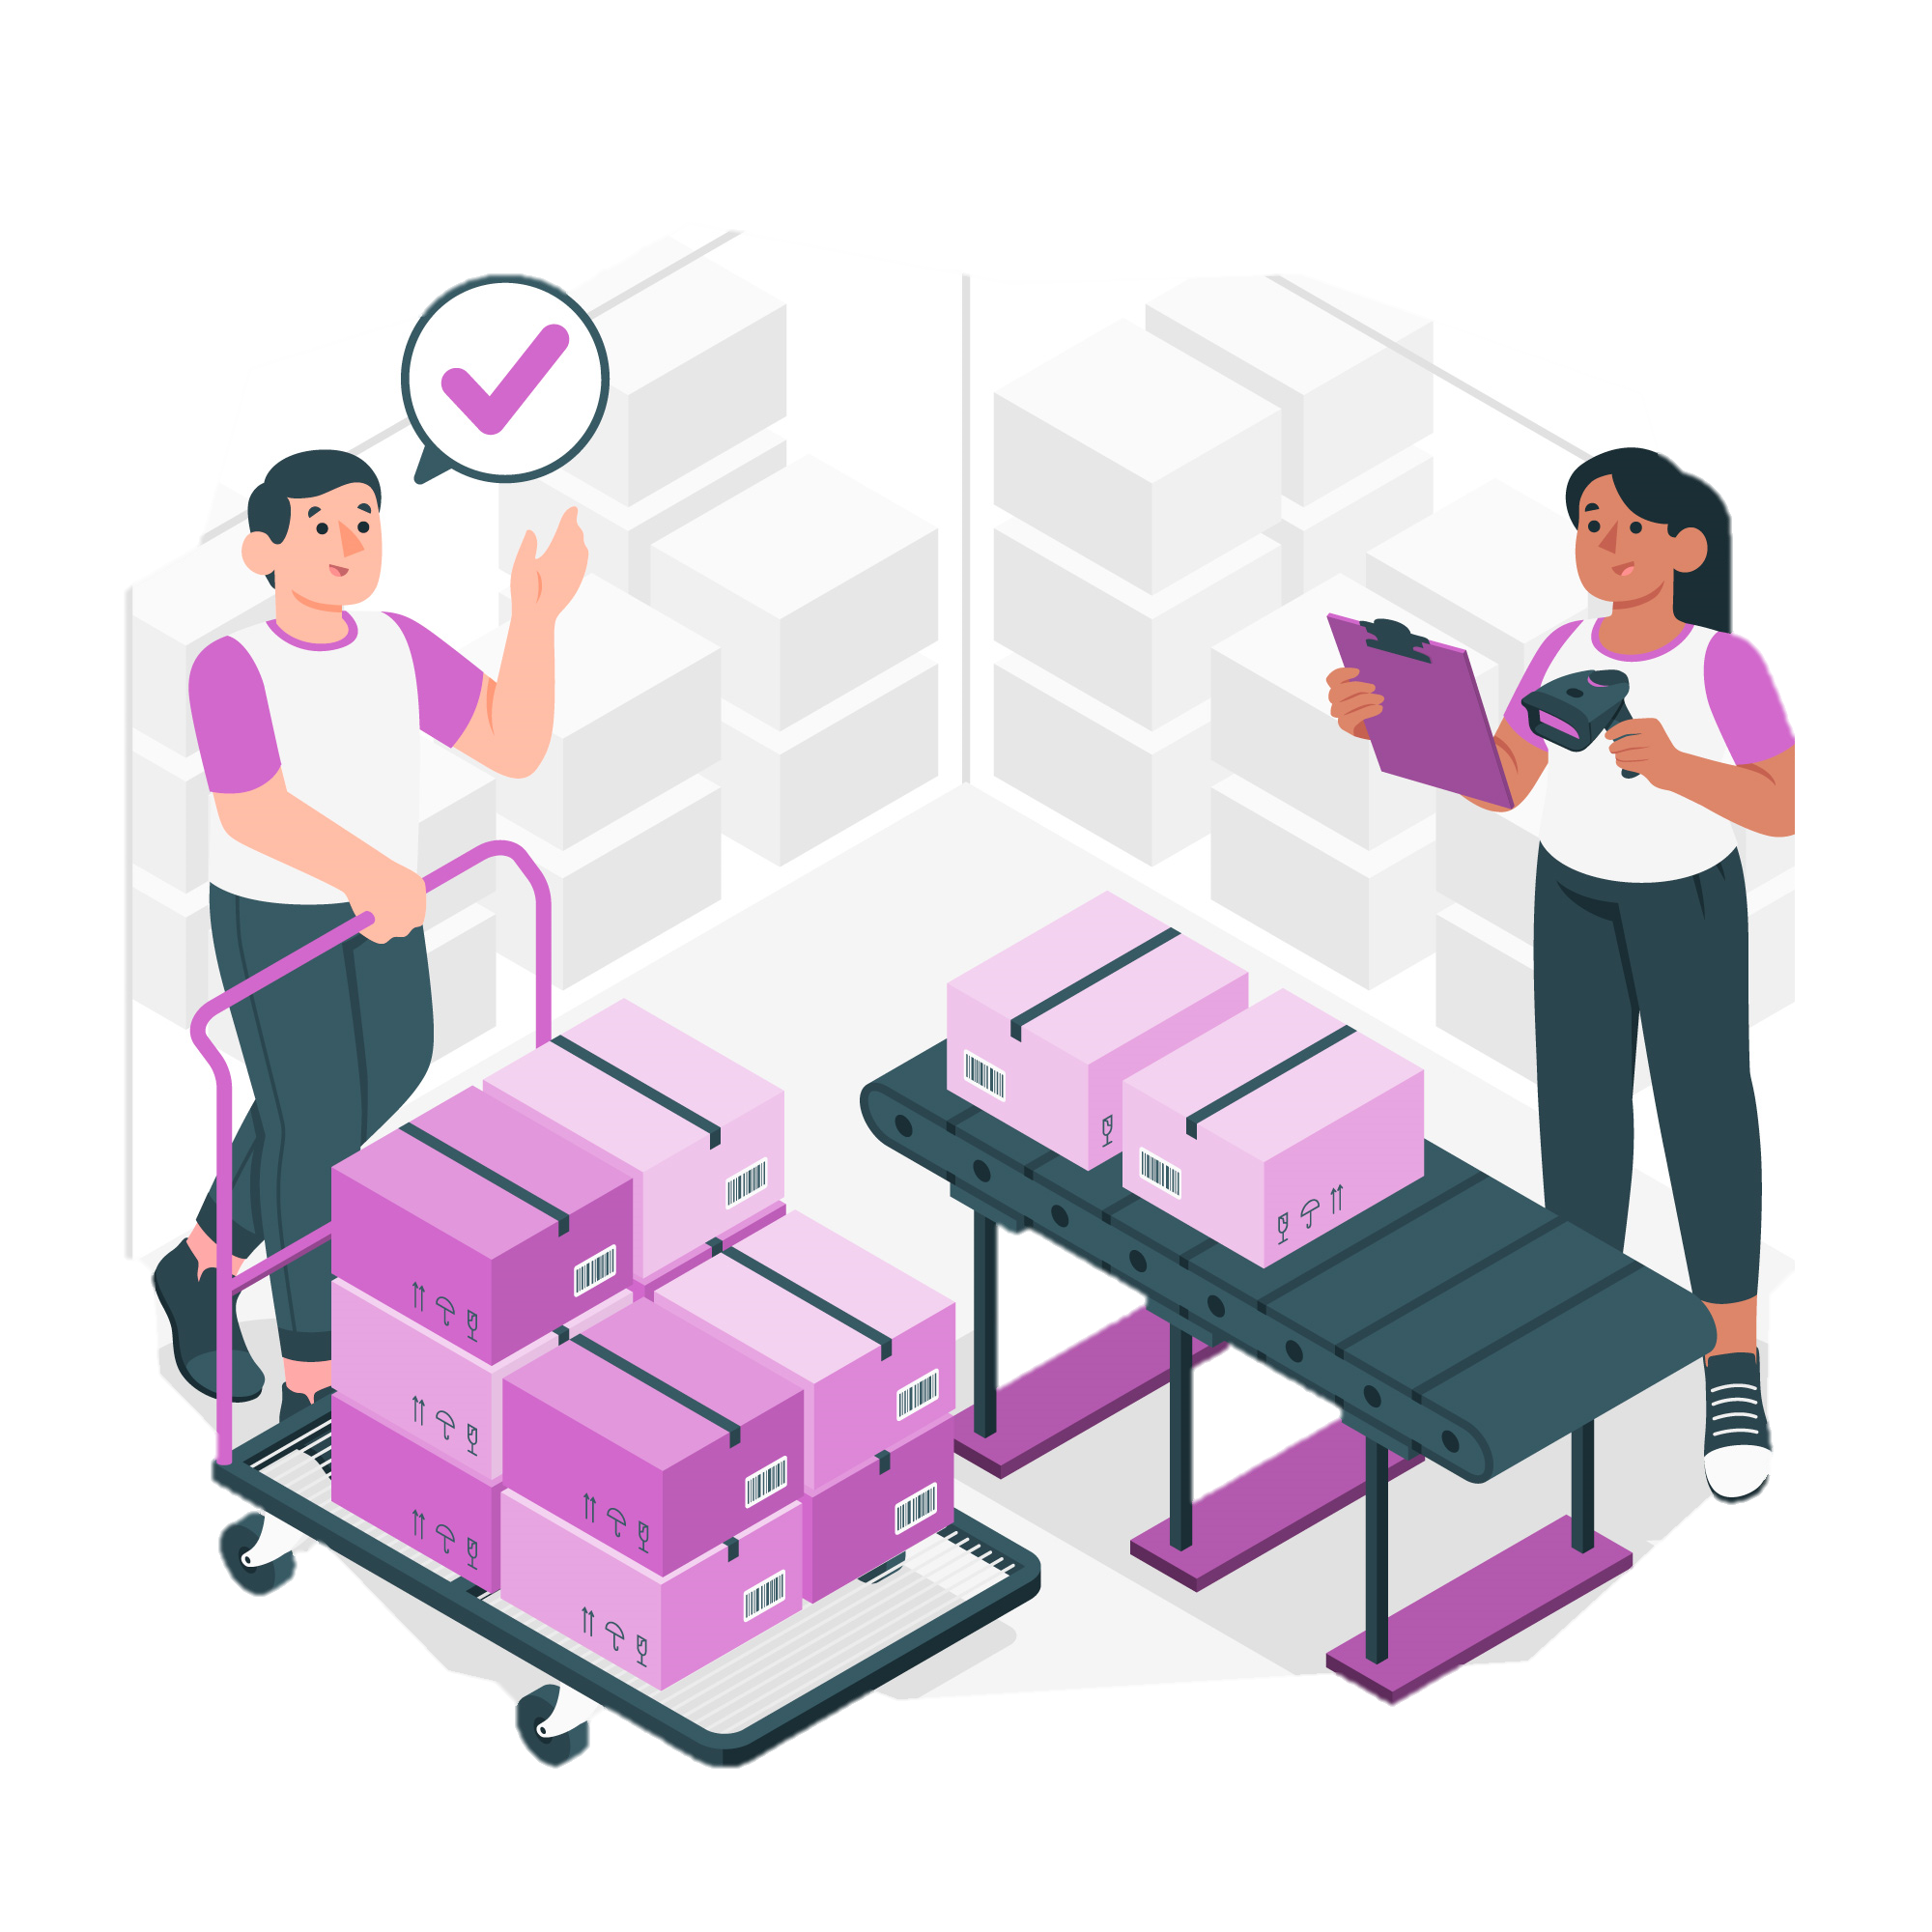
Inventory Control System Final Presentation
Project Manager: Luis Cortes
An overview of the project and its’ implementation
Names: Luis Cortes, Rabia Mehdi, Kegan Oyeronbi
Instructor: Professor Thompson
CIST 2931: Advanced Systems Project
Date: November 29, 2023

Slide 2

introduction
Projects should always have a place on the resume, and creating a project that interfaces with SQL as a CRUD application is a great one to have.
Our Progress is steady, and we learn more and more about project development and management with each new module.
Team:
Project Manager: Luis Cortes
Java Specialist: Kegan Oyeronbi
SQL Specialist: Rabia Mehdi
All Computer Programming Majors

Slide 3
Project Details

Slide 4
Business Case
For any retail corporation, their inventory is the lifeblood of their business. We are creating a modernized inventory for an up-and-coming retail business as they expand their company into new heights.
Functionality:
SQL Backend
CRUD Functionality
Push Overstock Module
Price Change Event Module

Slide 5
Project Charter & Mission Statement
Charter
We are committed to revolutionizing the way our retail store manages its inventory. Our mission is to design and develop a cutting-edge backend system using Java that empowers our client to efficiently create, read, update, and remove inventory items.
Mission Statement
The new system with CRUD capabilities and sorting criteria (name, category, price, margin) will enhance inventory control, streamline operations, and ensure optimal product availability. This directly aligns with the mission of maximizing profitability and operational efficiency while offering a diverse range of products to customers.

Slide 6
Project Scope
If an item’s cost is risen, an event will appear to change it’s price
SQL Backend
Using a SQL Database to store all items with variables
CRUD Functionality
Create, Read, Update, Delete functionality of all items in the SQL DB
Easy to use UI
User Friendly UI for retail colleagues to quickly and efficiently parse data
Check shelf capacity versus balance on hand to create a retail event
Price Change Event Module
Push Overstock Module

Slide 7
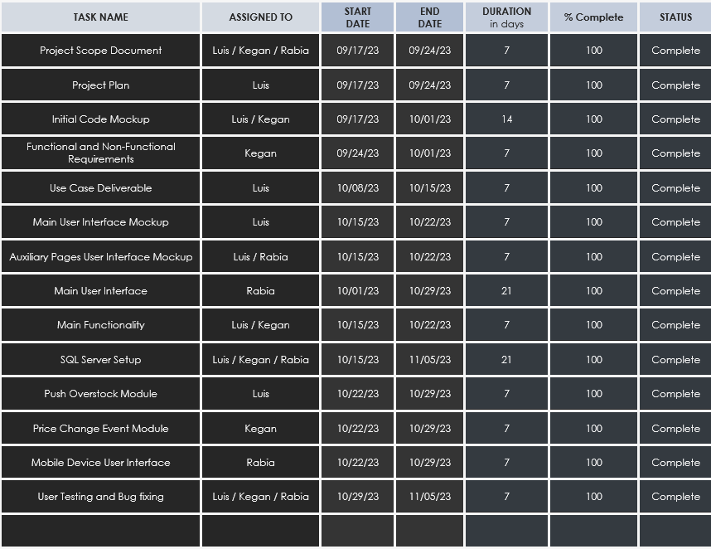
project plan
The project is based in Java with heavy SQL integration. Our project plan revolves around mostly our planning pieces, with longer stretches for our actual code creation.

Slide 8
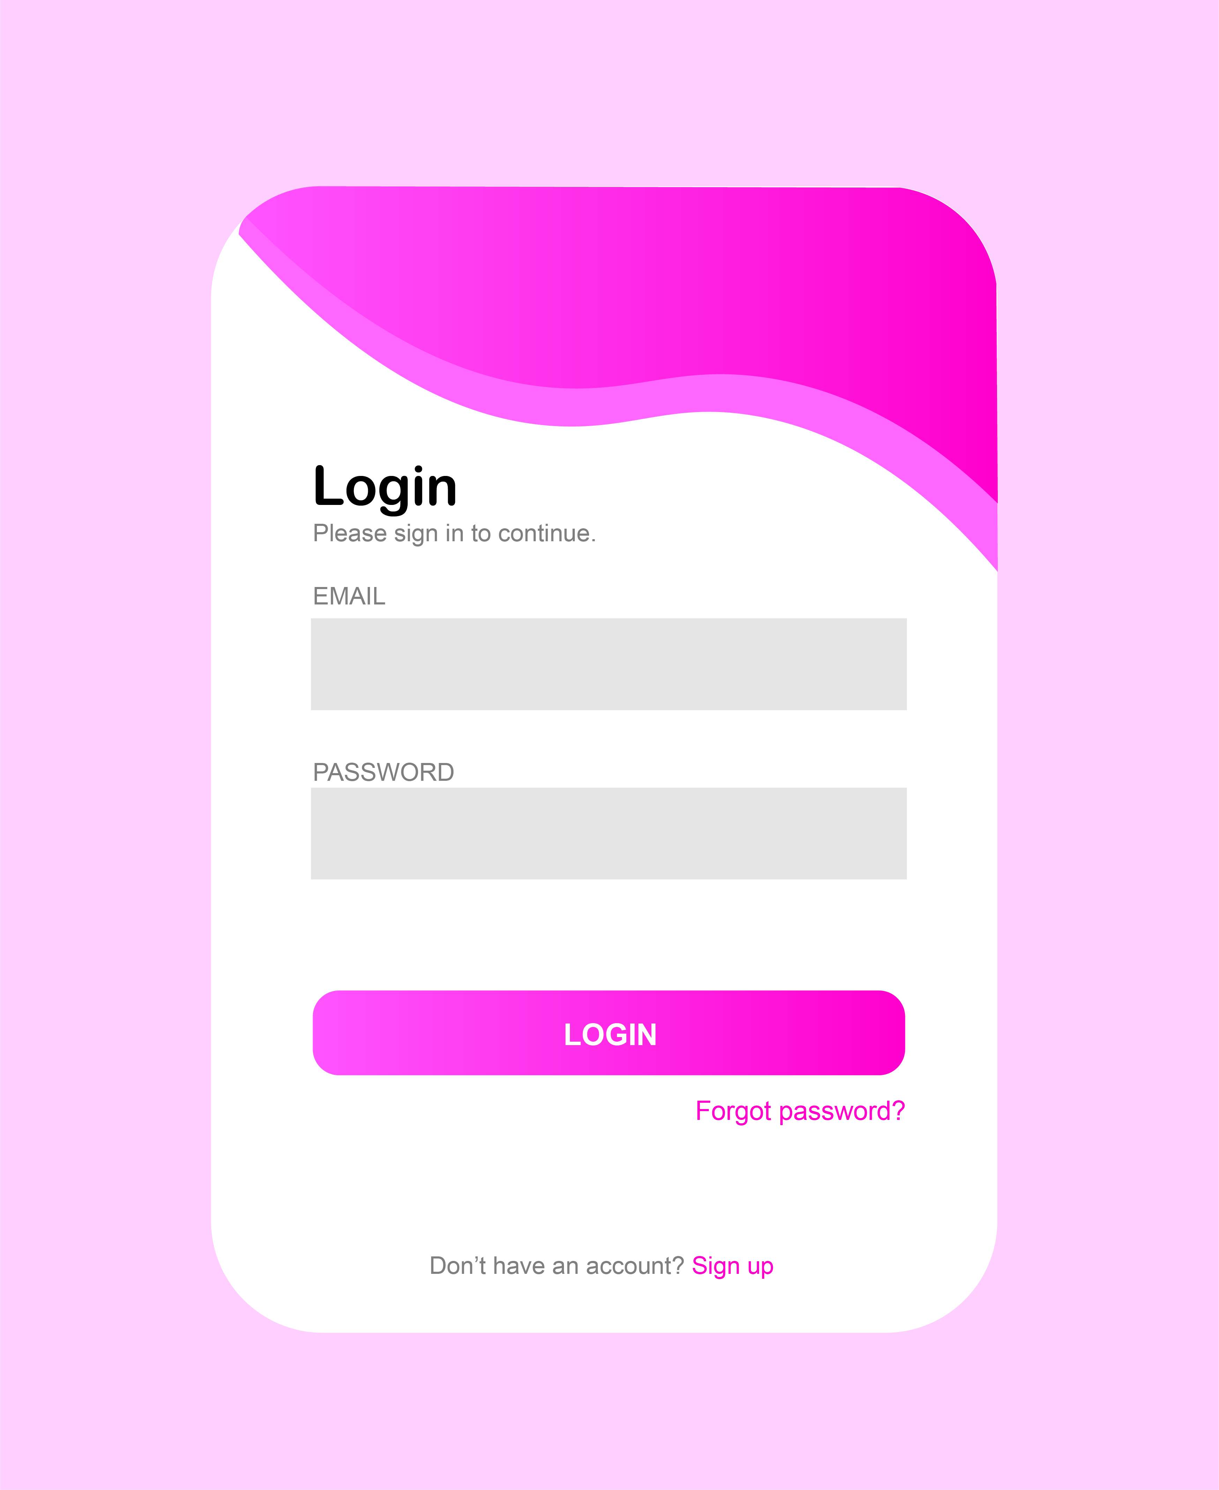
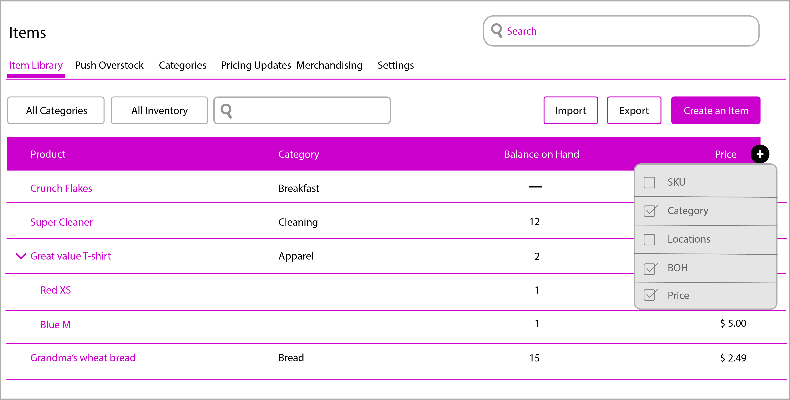
beta user interface
Login Screen
Main inventory Screen
Simple login screen, using SQL to verify user
Inventory UI, strong emphasis on functionality and ease of use

Slide 9
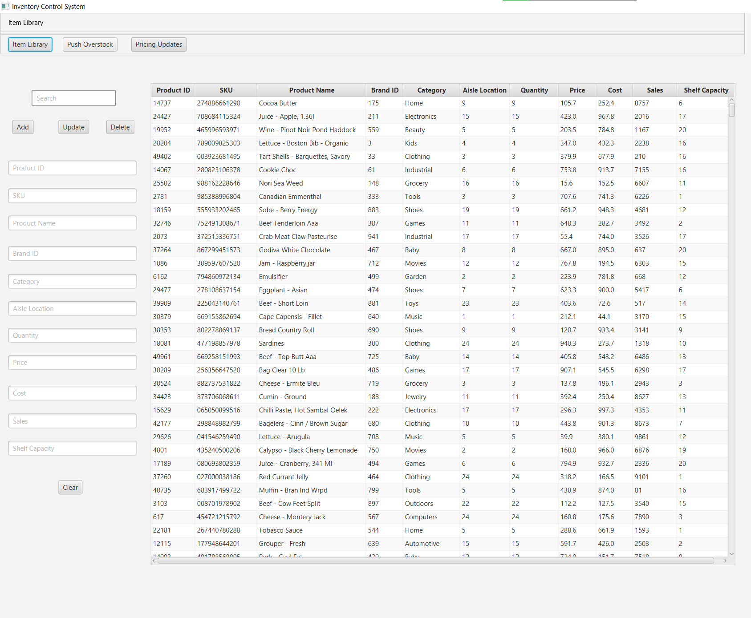
final user interface
Main inventory Screen
Inventory UI, strong emphasis on functionality and ease of use

Slide 10
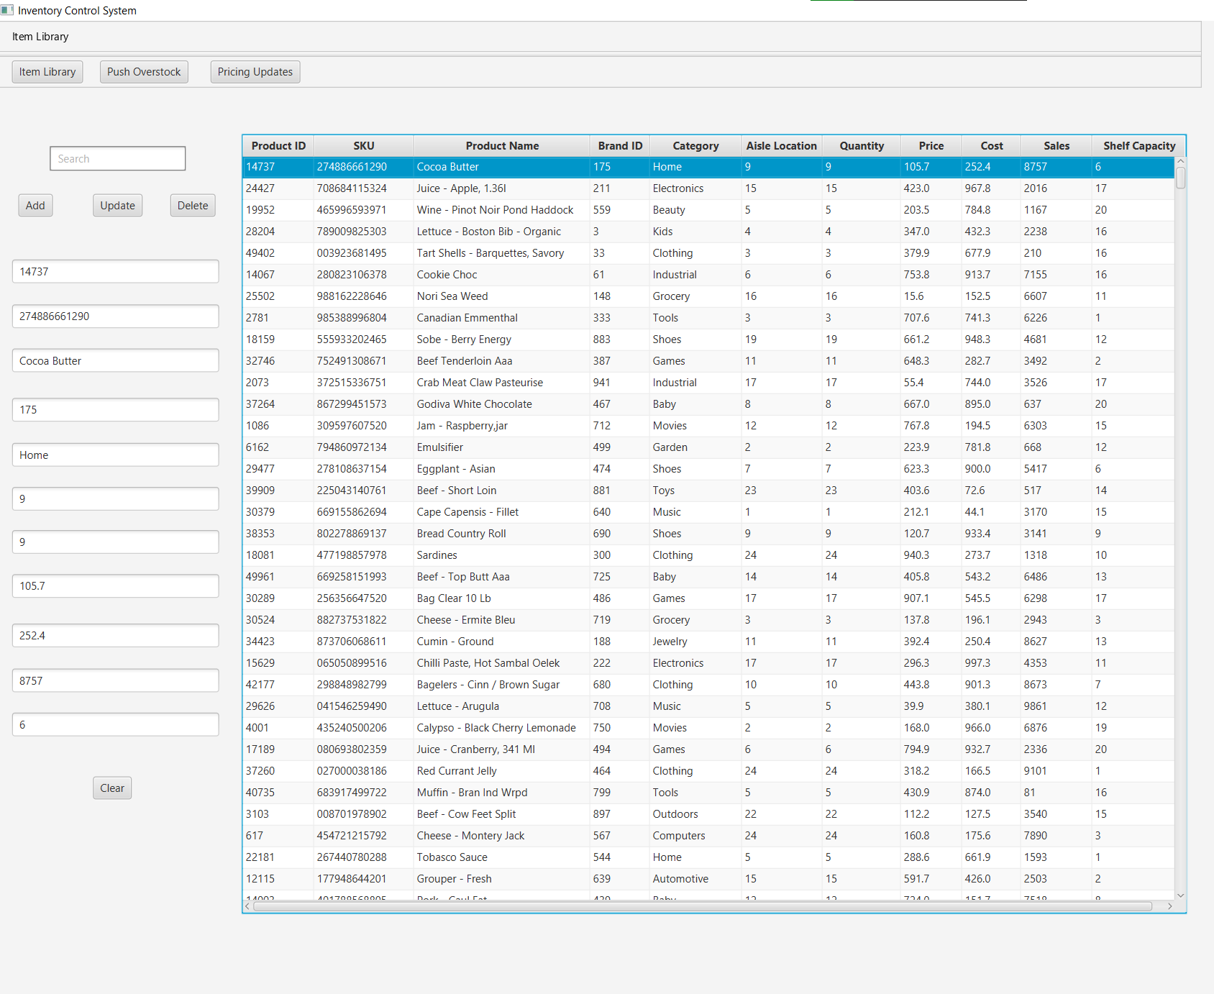
final user interface
Main inventory Screen
Populates the text fields on selection for ease of modification

Slide 11
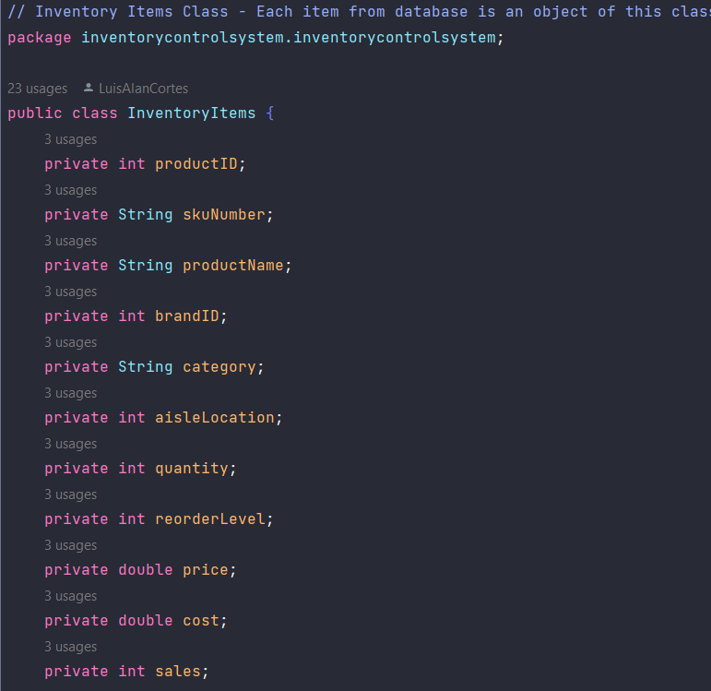
Inventory Items Class Code Snippet
Class to hold each entry in inventory database.

Slide 12
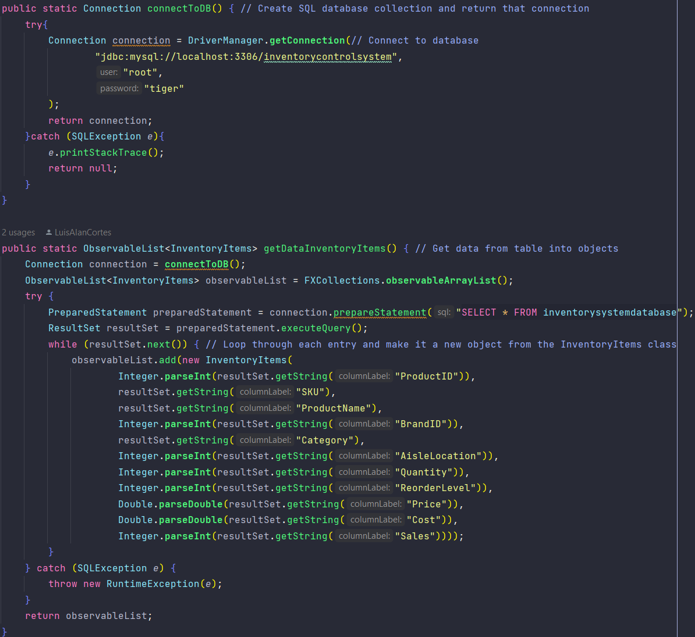
SQL Connection Code Snippet
Looping through the database, we add each entry into a new inventory item class object.

Slide 13
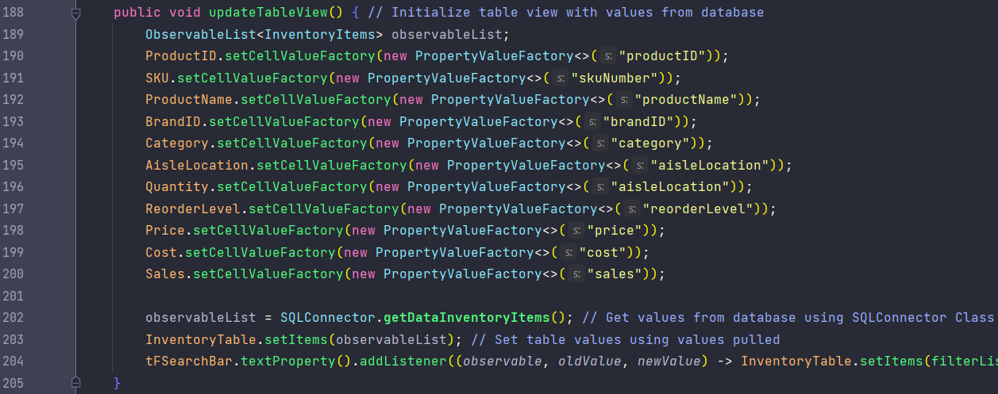
Table View Loader Code Snippet
Set each table view column and row based on data from the SQL table, loaded into an observable list.

Slide 14
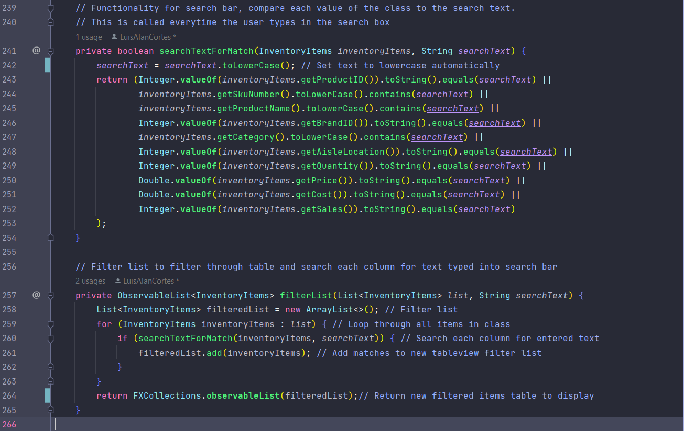

Search Function Code Snippet
Using a filtered list and a listener that checks for any change in the search bar, the function checks every string entered against the database and returns the new list to the table view.

Slide 15
core test plan
Data
Test core functionality of database functionality
UI NAV
Verify UI navigation operates properly
Push Overstock
Test functionality of push overstock module
Price Update
Test functionality of price update module
Mobile ui
Verify mobile UI navigation operates properly and scales properly

Slide 16
suggested enhancements
Item search between store locations
Barcode functionality
Inventory optimization based on sales
Automated item ordering
Demand forecasting
Cycle Count function

Slide 17

difficulties
Deciding on what to leave on the cutting room floor is a very difficult task for a project you are interested in.
Project management is difficult and requires a lot of forward thinking, much more then expected
Working on a project with a team over the internet is more difficult then anticipated, with varying schedules and communication methods

Slide 18

successes
Solving the SQL to Java integration was a challenge, but a great one to overcome.
Solving problems as a diverse team was a great experience.
Project management is extremely rewarding once you see those modules come together into those final big pieces.

Slide 19
Takeaways & Advice
Creating tools that are useful for people and will be used by them is one of the greatest projects to put on a portfolio.
Project management is easy to get wrong, and very hard to get right. timelines are your best friend, and worst enemy.
nothing comes close to doing, the best way to learn is through experience with a system. creating a project with SQL integration really deepened our understanding of those underlying systems.

Slide 20
thank you
Let us know if you get a programming job, ASAP.

Slide 21
references
Abstract Vectors by Vecteezy
https://www.vecteezy.com/free-vector/abstract“
Images by Freepik
https://www.freepik.com/free-vector/deadline-isometric-icon_23182838.htm#page=2&query=corporate%20illustration%20inventory%20challenge&position=4&from_view=search&track=ais

